Slide 1
Intelligent Services Managing Machine Learning in Production
Joseph E. Gonzalez
joseph@dato.com; Co-Founder @ Dato Inc.
jegonzal@cs.berkeley.edu; Assistant Professor @ UC Berkeley

Slide 2
Training
Data
Model
User | Item | Rating
f (user, item) →
Pred. Rating
Notes:
Connect to political bias story
----- Meeting Notes (2/3/15 11:29) -----
Example of Data and Model use amazon model

Slide 3
Frameworks and Systems
Create
BIDMach
MLlib
VW
LIBSVM
Oryx 2
MLC

Slide 4
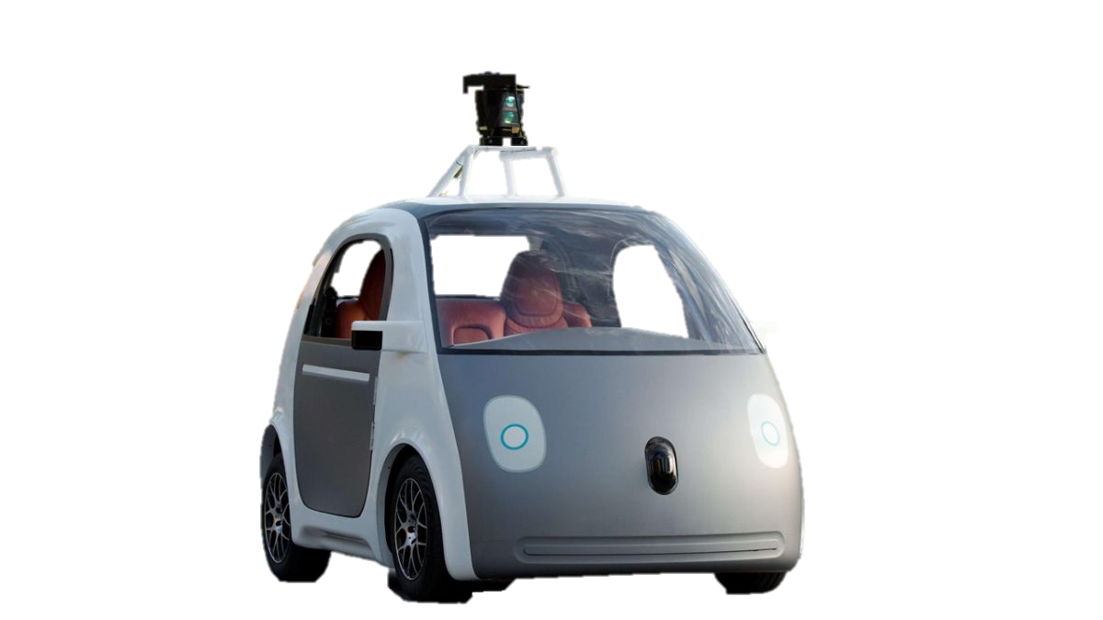
What happens after we train a model?
Data
Training
Model
Conference
Papers
Dashboards and
Reports
Drive Actions
Notes:
Connect to political bias story
----- Meeting Notes (2/3/15 11:29) -----
Example of Data and Model use amazon model

Slide 5
What happens after we train a model?
Data
Training
Model
Conference
Papers
Dashboards and
Reports
Drive Actions
Notes:
Connect to political bias story
----- Meeting Notes (2/3/15 11:29) -----
Example of Data and Model use amazon model

Slide 6







Suggesting Items at Checkout
Fraud Detection
Cognitive Assistance
Internet of
Things
Low-Latency
Personalized
Rapidly Changing

Slide 7
Data
Train
Model
Notes:
Connect to political bias story
----- Meeting Notes (2/3/15 11:29) -----
Example of Data and Model use amazon model

Slide 8
Actions
Adapt
Serve
Data
Train
Model
Notes:
Connect to political bias story
----- Meeting Notes (2/3/15 11:29) -----
Example of Data and Model use amazon model

Slide 9
Machine
Learning
Intelligent
Services

Slide 10















Retail
Search
Coupons
Movie Distribution
Networking
Music
INTELLIGENT
Services
Campaigning
Advertising
Real Estate
Human Resources
Legal Advice
Dating
Wearables
Taxis
CRM
Notes:
we are seeing industry after industry being disrupted by companies that build intelligent applications
amazon
netflix
pandora
adsense
uber
and these intelligent applications use machine learning at their core
so, revisiting that childhood dream, I can say...

Slide 11

The Life of an Intelligent Query
Lookup
Model
Request:
Items like x
Top-K
Query
Model
Info
μ
∫
σ
Feature
Lookup
Intelligent Service
α
Math
User
Data
New Page
Images …
Top
Items
Web Serving Tier
ρ
∑
β
Feature Lookup
User
Feedback
Product
Info
Feedback:
Preferred Item
Content Request

Slide 12


The Life of an Intelligent Query
Lookup
Model
Request:
Items like x
Top-K
Query
Model
Info
Feature
Lookup
Intelligent Service
Intelligent Service
User
Data
Top
Items
UC Berkeley AMPLab
New Page
Images …
Web Serving Tier
Daniel Crankshaw, Peter Bailis, Haoyuan,
Zhao Zhang, Michael J. Franklin, Ali Ghodsi, and Michael I. Jordan
Feature Lookup
User
Predictive Services
Feedback
Product
Info
Feedback:
Preferred Item
Commercial
Production System
Open-Source Research Project
Content Request

Slide 13
Dato Predictive Services Architecture
Elastic scaling with EC2
on premise support as well.
Elastic Load
Balancer
Worker
SFrame + Create
Model Training
Redis Dist. Cache
Worker
Metrics
CloudWatch
Python
Mngt. Client
S3 Persistent
Storage

Slide 14
UC Berkeley Velox Architecture
Cluster deployment based on BDAS:
BDAS: Berkeley Data Analytics Stack
Client
Load Balancer
Worker
Spark Mllib +
Keystone-ML
Tachyon KV-Store
Worker
Metrics
CloudWatch
Config
Scripts
HDFS
Storage

Slide 15
Essential Attributes of Intelligent Services
Responsive
Adaptive
Manageable
Intelligent applications are interactive
ML models out-of-date the moment learning is done
Many models created by multiple people

Slide 16
Responsive: Now and Always
Compute predictions in < 20ms for complex
Models
Queries
Features
SELECT * FROM
users JOIN items, click_logs, pages WHERE …
Top K
under heavy query load with system failures.

Slide 17
The Common Solutions to Latency
Faster Online Model Scoring
Pre-Materialization and Lookup
“Execute Predict(query) in
real-time as queries arrive”
“Pre-compute Predict(query) for all queries and lookup answer at query time”

Slide 18
Dato Predictive Services Does Both
Faster online model scoring:
SFrame native code, optimized data frame
Pre-Materialization and Lookup:
redis distributed cache
automatic cache warming
Caching
is
Smart Materialization
Notes:
Feature caching to accelerate feature lookup not yet implemented
Default feature values not yet implemented

Slide 19
Distributed shared caching
Cache:
Model query results
Common features (e.g., product info)
Scale-out improves throughput and latency
Distributed Shared Cache (Redis)

Slide 20
Caching == Smart Materialization
Queries are typically power-law distributed.
Example: top 10% of all unique queries cover 90% of all queries performed.
Query Frequency
Cache Warming: Pre-materialize model for common queries
Query Distribution
Unique Queries

Slide 21
Dato Latency by the numbers
Easy Case: cache hit ~2ms
Hard Case: cache miss
Simple Linear Models: 5-6ms
Complex Random Forests: 7-8ms
P99: ~ 15ms
Notes:
~ 30 Features Random Forrest for cache miss 7-8 ms (end-to-end) client-through server-client
~ Linear model are typically < 7-8 ms
~ random forrest p99 ~ 15ms (0cache)
~ random forrest p99 ~ 5/6 ms (100% cache)
Client in same region ec2

Slide 22
Velox Model Serving System
[CIDR’15]
Personalized Models (Mulit-task Learning)
Input
Output
“Separate” model for each user/context.

Slide 23
Velox Model Serving System
[CIDR’15]
Personalized Models (Mulit-task Learning)
Feature Model
Personalization
Model
Feature Caching across Users
Light-weight
Personalization
Model
Anytime Feature Evaluation
Approximate
Features
Split

Slide 24


Adapting to Change at All Scales
Population Granularity of Data Session
Shopping for Mom
Shopping for Me
Months Rate of Change Minutes
New users and products
Evolving interests and trends
Notes:
: New features are
Customer interests evolve within sessions
Need to collect the right data to make the best predictions.

Slide 25
Adapting to Change at All Scales
Population Granularity of Data Session
Population
Law of Large Numbers
→ Change Slow
Rely on efficient offline retraining
→ High-throughput Systems
Shopping for Mom
Shopping for Me
Months Rate of Change Minutes
Months
New users and products
Evolving interests and trends
Notes:
: New features are
Customer interests evolve within sessions
Need to collect the right data to make the best predictions.

Slide 26
Adapting to Change at All Scales
Population Granularity of Data Session
Small Data → Rapidly Changing
Low Latency → Online Learning
Sensitive to feedback bias
Shopping for Mom
Shopping for Me
Months Rate of Change Minutes
Notes:
: New features are
Customer interests evolve within sessions
Need to collect the right data to make the best predictions.

Slide 27
The Dangerous Feedback Loop
My Amazon Homepage
I once looked at cameras on Amazon …
Bags
Similar cameras and accessories
How would they learn that I also
like kites and archery?

Slide 28
Exploration / Exploitation Tradeoff
Systems that can take actions can adversely bias future data.
Exploration Exploitation
“Random”
Action
“Greedy”
Action
Tradeoff must be addressed in real-time!

Slide 29
Dato Solution to Adaptation
Rapid offline learning with GraphLab Create
Fast linear time algorithms
Process 10’s billions of records per minute.
Online bandit adaptation in Predictive Services
Models compete dynamically

Slide 30
Personalized Adaptation in Velox
Feature Model
Personalization
Model
Split

Slide 31
Personalized Adaptation in Velox
Update feature functions offline using batch solvers
Leverage high-throughput systems (Apache Spark)
Exploit slow change in features
Feature Model
Personalization
Model
Update the user weights online:
Stochastic Gradient Descent → Fast
Doesn’t conflict with other users
Split

Slide 32
Essential Attributes of Intelligent Services
Responsive
Adaptive
Manageable
Intelligent applications are interactive
ML models out-of-date the moment learning is done
Many models created by multiple people

Slide 33
Management: Collaborative Development
Teams of data-scientists working on similar tasks
“competing” features and models
Complex model dependencies:
Cat Photo
isCat
isAnimal
Cat Classifier
Animal
Classifier
Cute!
Cuteness
Predictor

Slide 34
Velox Model Management
Track feature dependencies
Share feature functions calculations across models
Online-learning → robust to feature changes

Slide 35
Dato Model Management
Rich logging and metrics
Model routing / aliasing
Hot-swap models on the fly
Bandits for collaborative model development

Slide 36
Demo

Slide 37
UC Berkeley AMPLab
Daniel Crankshaw, Peter Bailis, Haoyuan,
Zhao Zhang, Michael J. Franklin, Ali Ghodsi, and Michael I. Jordan
Predictive Services
Responsive
Adaptive
Manageable
Key Insights:
Caching, Bandits, &
Management
Split Model Formulation Online/Offline Learning

Slide 38
Machine Learning → Intelligent Services
Actions
Adapt
Serve
Data
Model
Train
Notes:
Connect to political bias story
----- Meeting Notes (2/3/15 11:29) -----
Example of Data and Model use amazon model

Slide 39
Thank You
Joseph E. Gonzalez
joseph@dato.com, Co-Founder @ Dato
jegonzal@cs.berkeley.edu, Assistant Professor @ UC Berkeley

Slide 40
What happens after we train a model?
Data
Training
Model
Notes:
Connect to political bias story
----- Meeting Notes (2/3/15 11:29) -----
Example of Data and Model use amazon model

Slide 41
What happens after we train a model?
Data
Training
Model
Notes:
Connect to political bias story
----- Meeting Notes (2/3/15 11:29) -----
Example of Data and Model use amazon model

Slide 42
Personalized Adaptation in Velox
Distributed
Batch Training
Feature Model
Personalization
Model
Online
Updates
(SGD)
Split

Slide 43
Update feature functions offline using batch solvers
Leverage high-throughput systems
Exploit slow change in features
Update the user weights online:
Stochastic Gradient Descent → Fast
Doesn’t conflict with other users

Slide 44
Velox: Learning from Personalized Feedback
Update the user weights online:
Stochastic Gradient Descent → Fast
Doesn’t conflict with other users
Update feature functions offline using batch solvers
Leverage high-throughput systems
Exploit slow change in features

